Slide 1
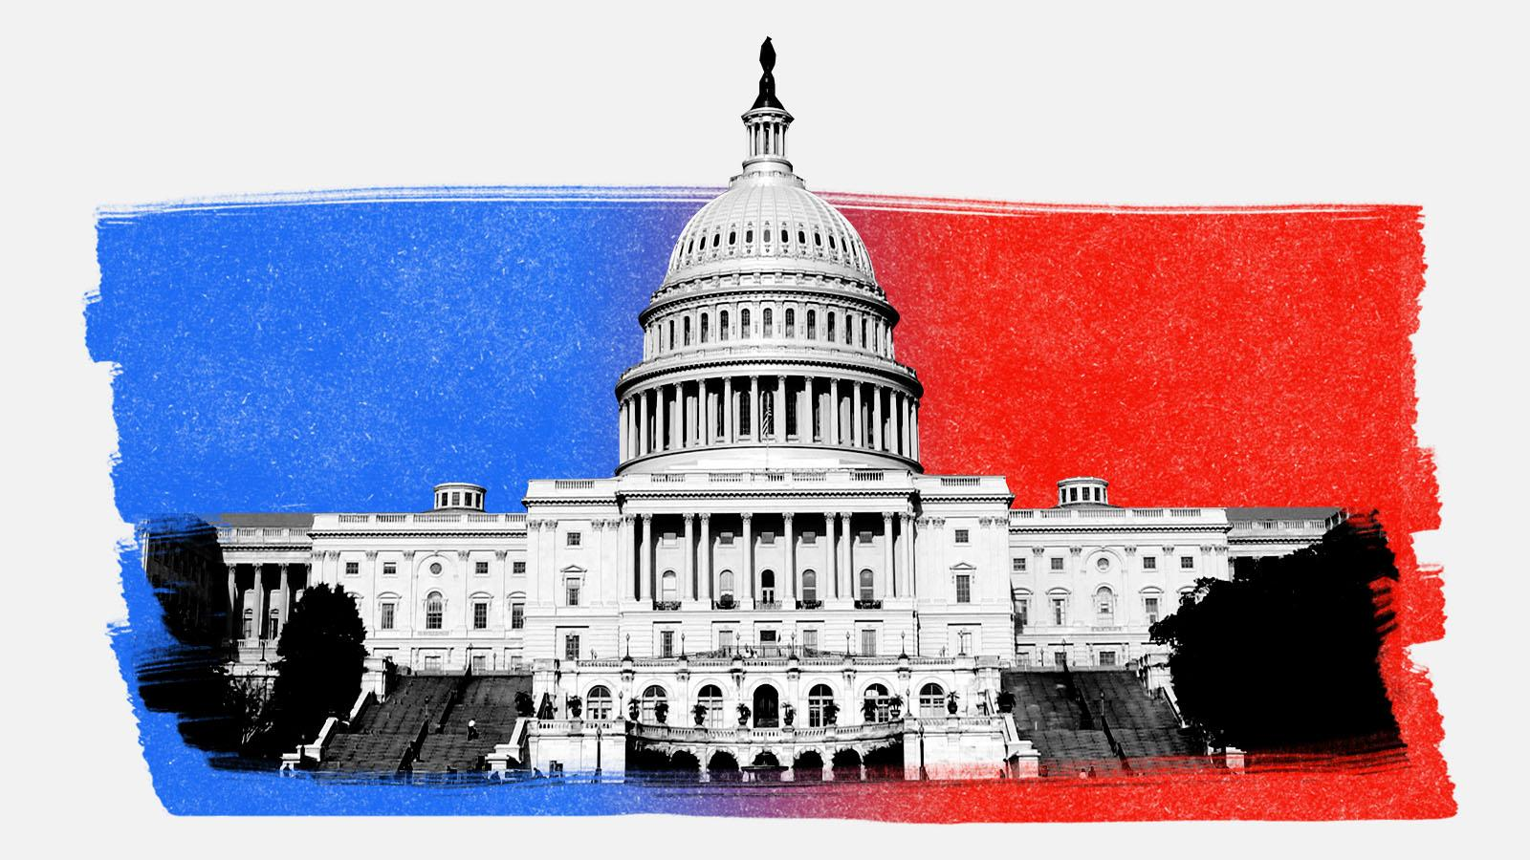
Analyzing Political Figures’ Tweets
Group Members:
Amr Elfiky
Tianyi Lu
Yuesong Shi
Edward Zamora

Slide 2
Motivations and Objectives
Twitter has become a major platform for political figures.
More and more prominent figures are using it to attack policies, express ideas, and communicate with their constituents.
“Viral” phenomenon increases exposure.
Do political figures have a certain way of speaking given their political affiliation?
Can the sentiment of a user determine their political affiliation?

Slide 3
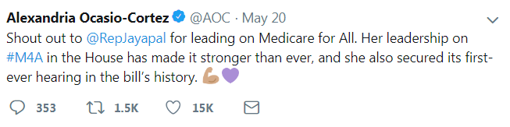
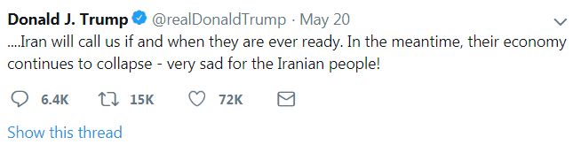
Approach
Collect Tweets from political figures and perform sentiment analysis.
Sentiment analysis will categorize the Tweet as positive, negative, or neutral.
More specifically, we will look for keywords in each tweet in order to extract sentiment.
Positive
7.0
- 4.0
Negative
[1] https://twitter.com

Slide 4
Methodology
Data Collection
  Data was collected using the Tweepy library, which interfaces with the Twitter API.
  Support for the following was added to our class
    Single query of user (variable number of Tweets)
    Query of users specified in a csv file
    Store data to a file, load data from a file
Text Preprocessing (‘data scrapping’)
  Tweets are “Dirty” and contain unnecessary data
  NLTK library for lemmatizing and cleaning
  Punctuation, nouns, hashtags, links, and @mentions are neutral and do not contribute to a Tweet’s sentiment
Sentiment Analysis
  The Afinn library was used which uses the AFINN lexicon of English terms manually rated for valence with an integer between -5 (negative) and +5 (positive).
Visualizations
  Republican Vs. Democrat
  Individual breakdown of party members
[2] https://github.com/tweepy/tweepy
[3] https://github.com/fnielsen/afinn

Slide 5
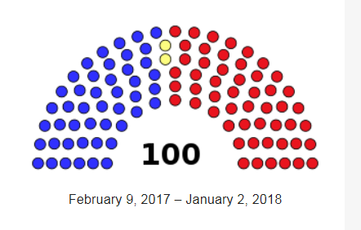
Dataset
115th United States Congress – Senate
Members include 100 senators
46 Democratic
  The two independents were considered Democratic based on previous party affiliations
54 Republican
100 Tweets from each
Twitter handles of all members
Csv file provided by socialseer.com, a simple call to one of our methods collected all data
Twitter Handle | Party
Amyklobuchar | D
BillCassidy | R
… | …
SteveDaines | R
[4] https://en.wikipedia.org/wiki/115th_United_States_Congress
[5] https://www.socialseer.com/resources/us-senator-twitter-accounts/

Slide 6
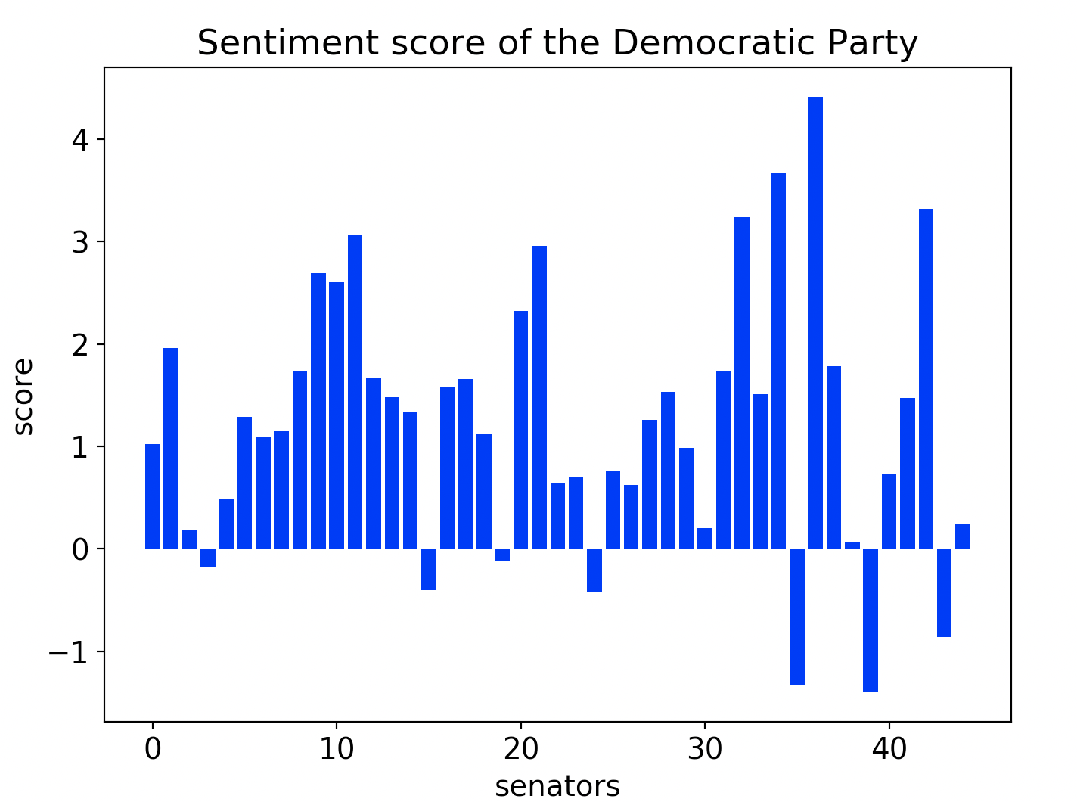
Sentiment Score Bar Graph

Slide 7
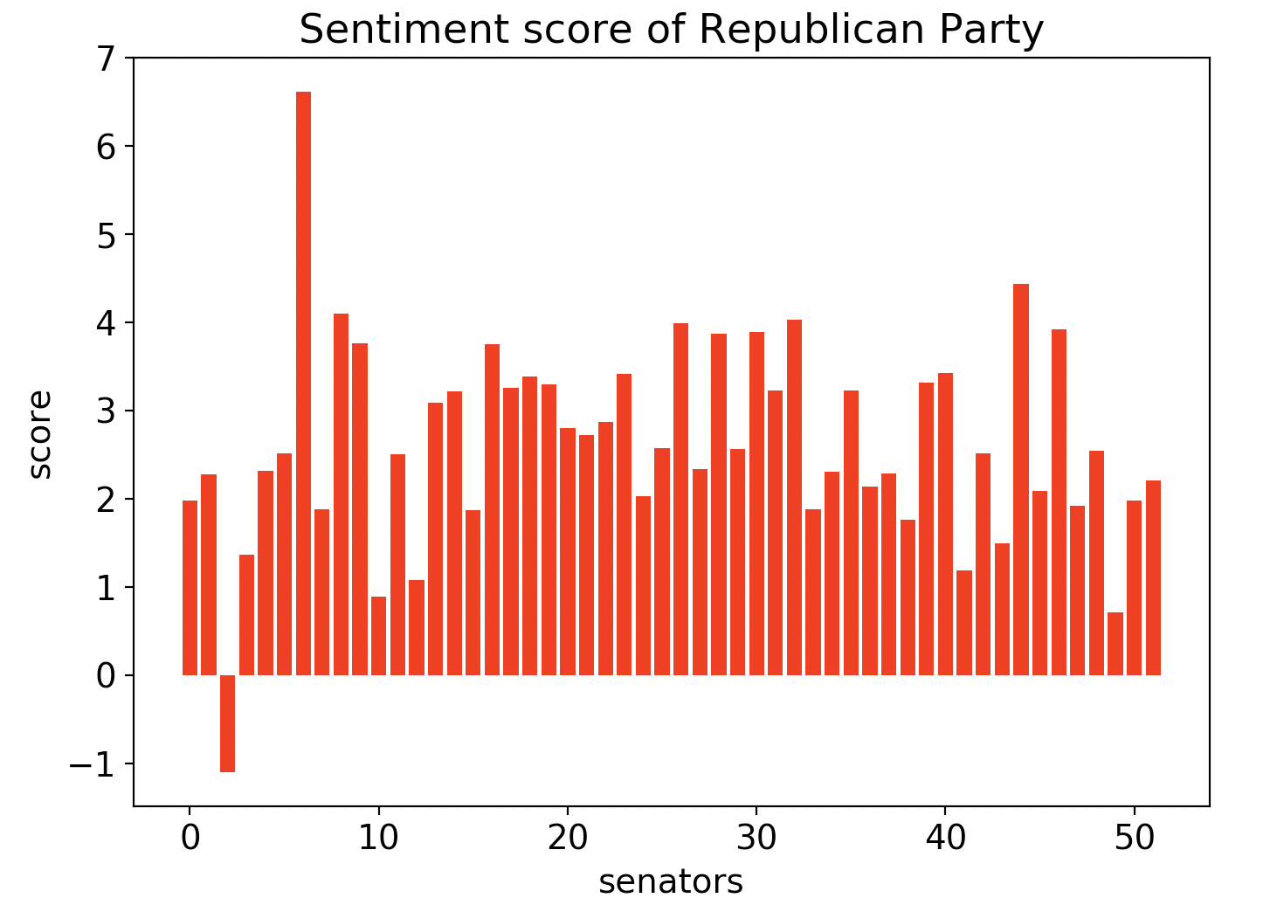
Sentiment Score Bar Graph

Slide 8
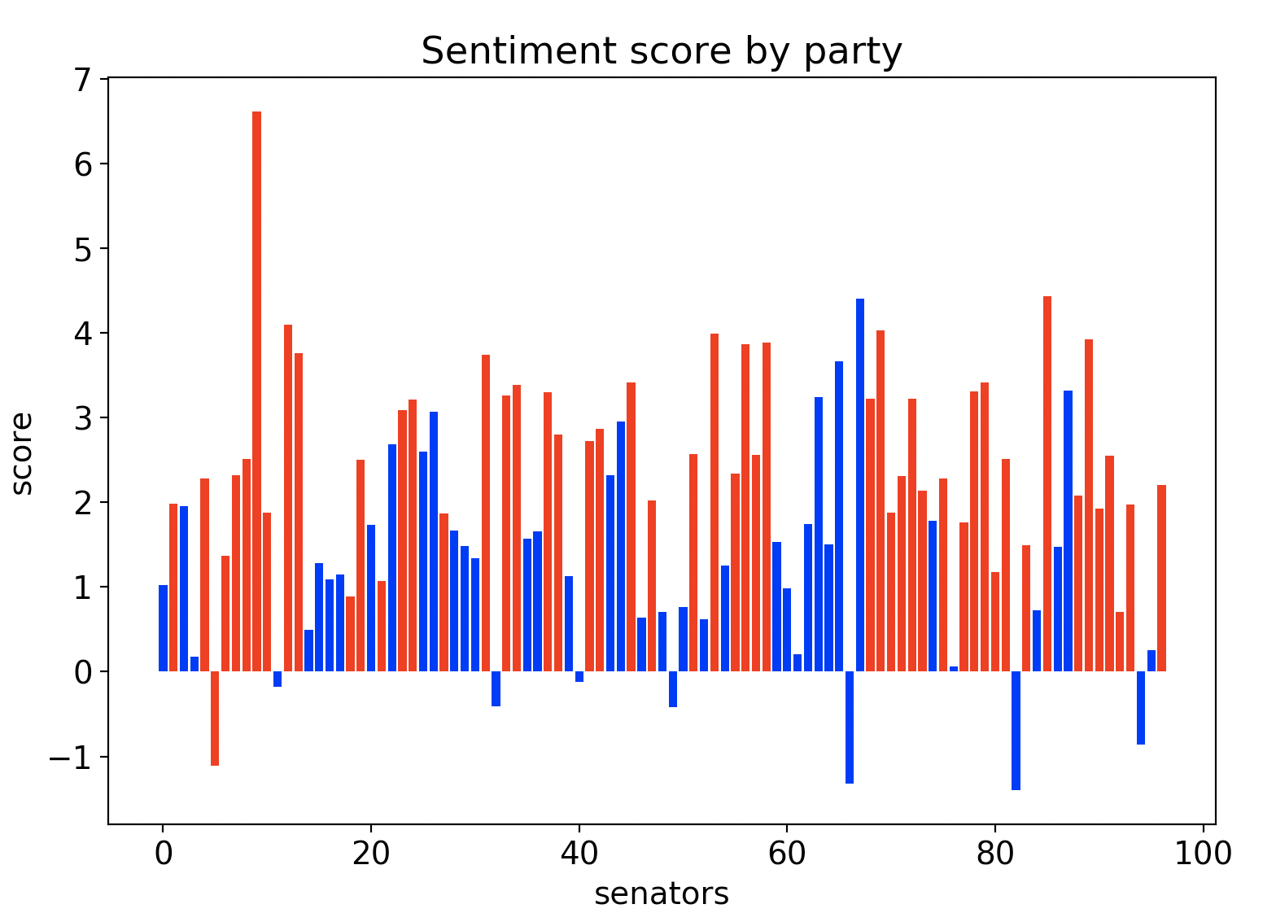
Sentiment Score Bar Graph

Slide 9
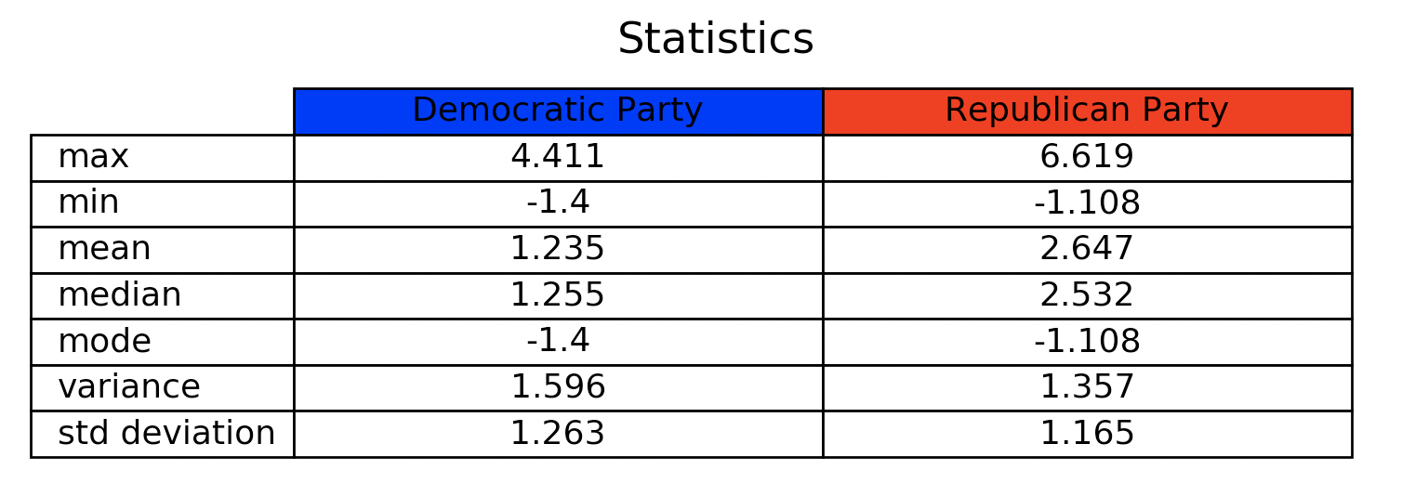
Sentiment Score Statistics

Slide 10
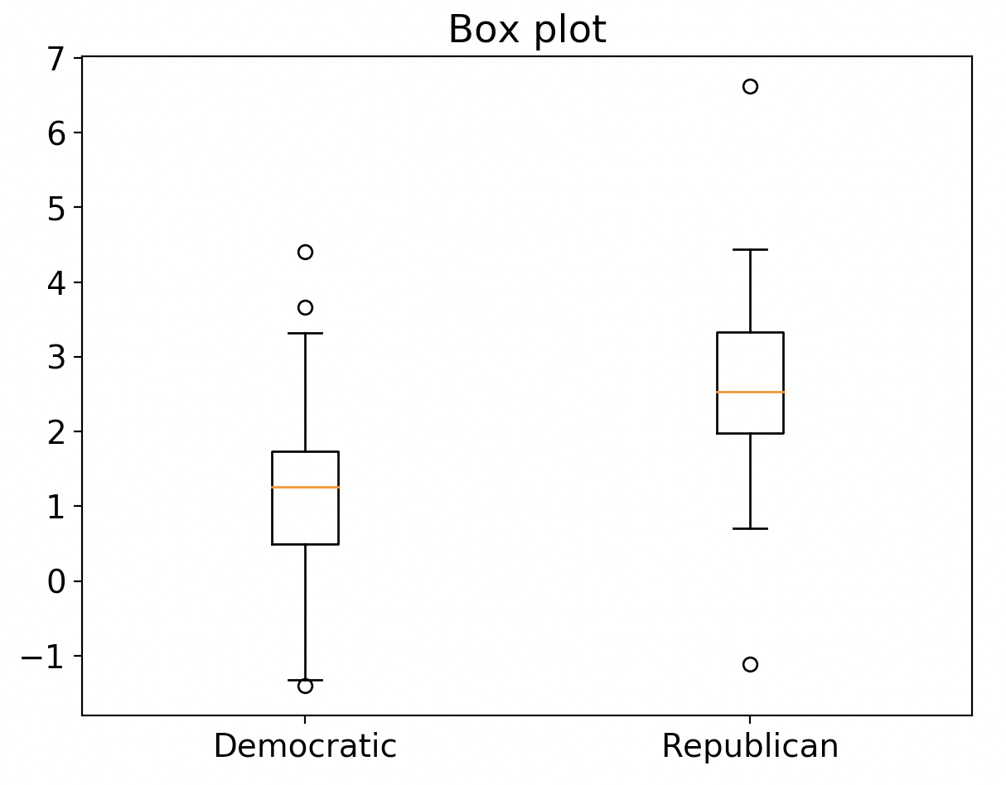
Box Plots
Score

Slide 11
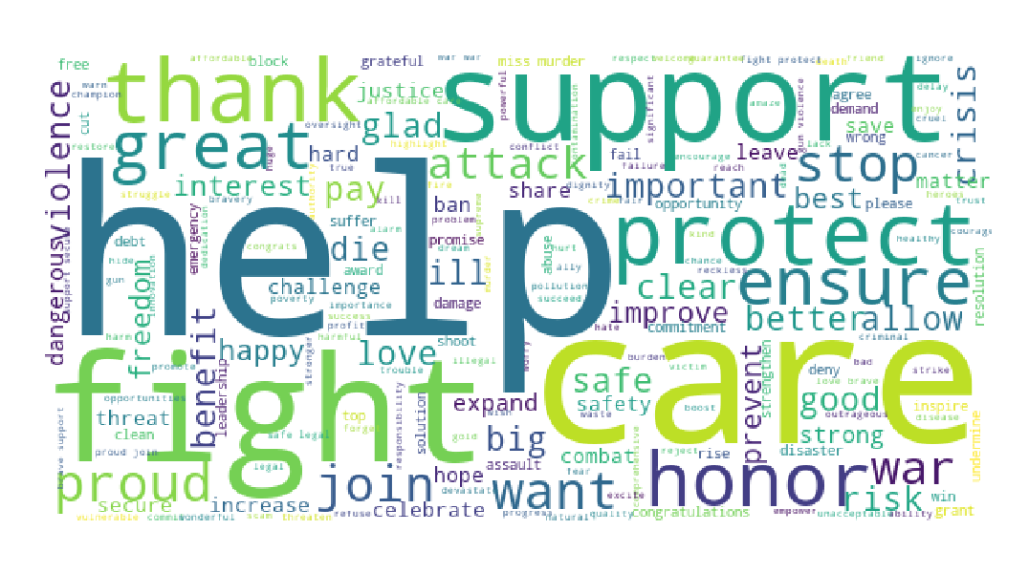
Word Cloud (Democrats)

Slide 12

Word Cloud (Republicans)

Slide 13
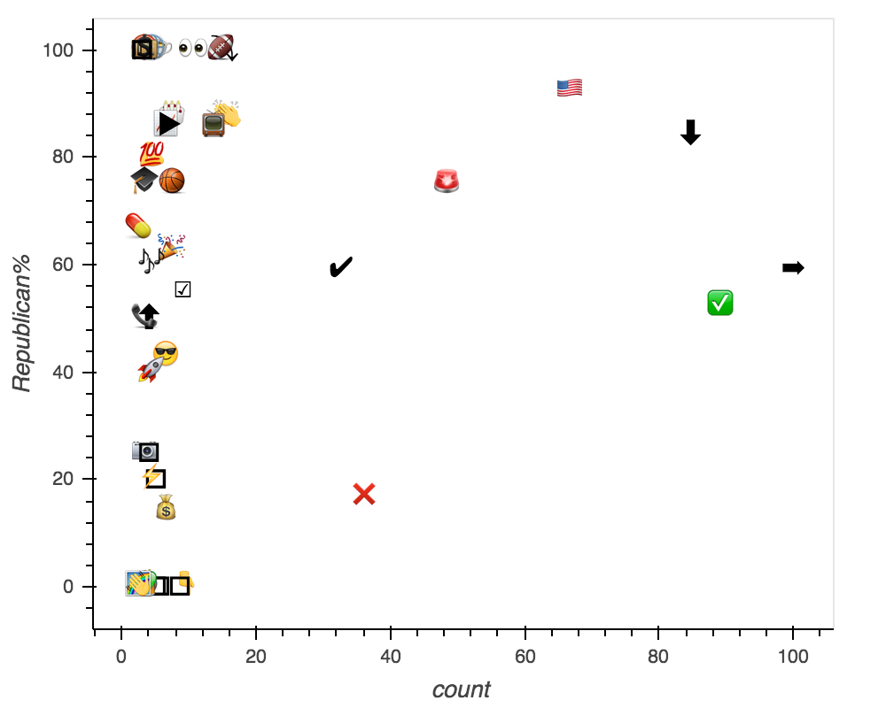
Top 50 used emojis across two parties

Slide 14
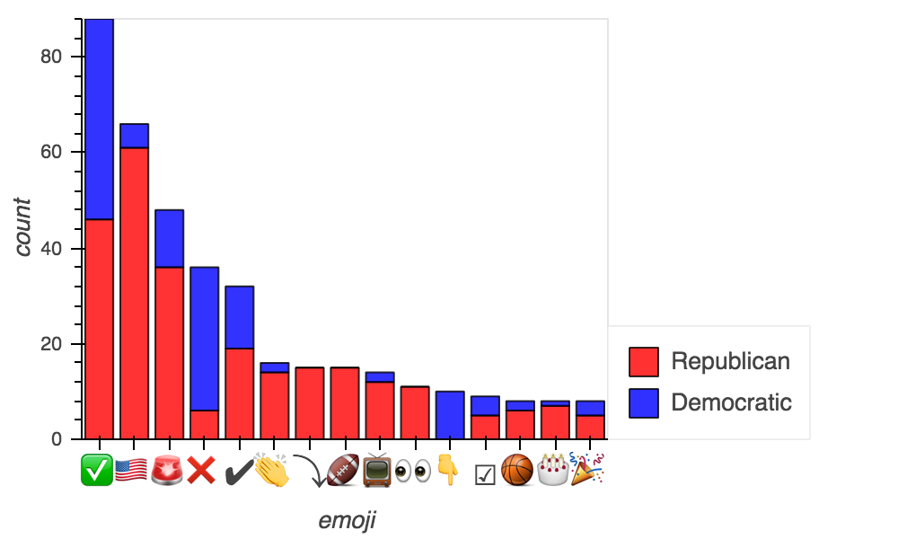
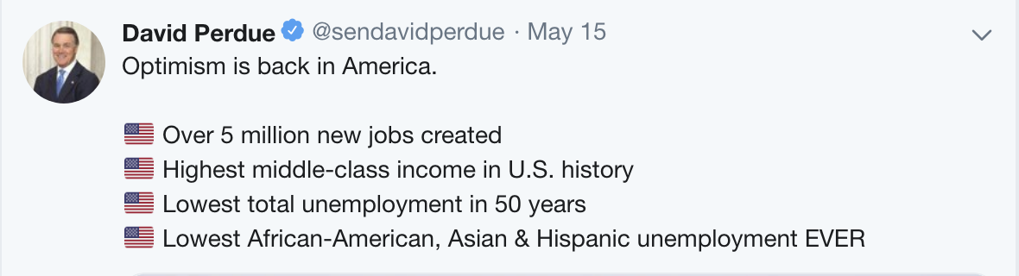

Slide 15
Conclusions
Republican party gives much more positive average response in tweets, nearly twice the Democratic party.
While the Republican party’s tweet scores has a slightly smaller standard deviation, both parties have a stable distribution.
  Most Tweets carry similar sentiments.
While Republicans tend to be more positive, it is not possible to determine political affiliation from a single account with certainty based on sentiment alone.
Potentially though, if given a large enough dataset (several users of the same party) we can with certainty determine political affiliation.

Slide 16
Special Thanks
Professor Unpingco
TA Ambareesh Jayakumari
TA Erik Seetao
UCSD ECE Department

